Slide 1
School Beautification
What does it look like?

Slide 2
What do you think?
What would you want to see at your school?
What should the playground look like?
What should the field look like?
What should the walls of the school look like?

Slide 3
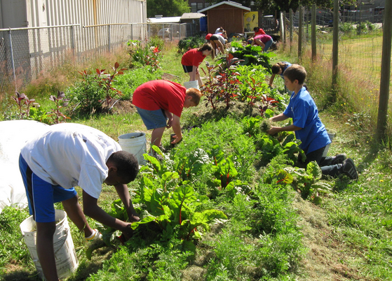
Gardens

Slide 4
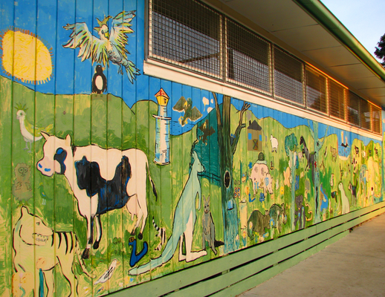
School Wall Paintings

Slide 5
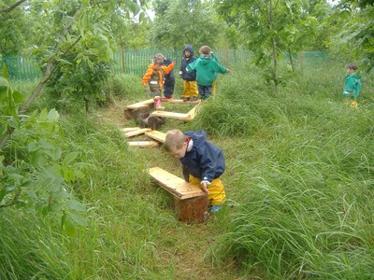
School Forest

Slide 6
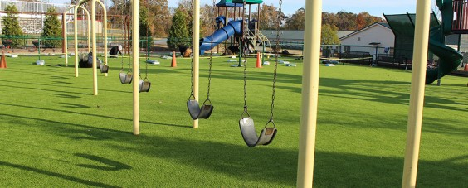
Larger Playground

Slide 7
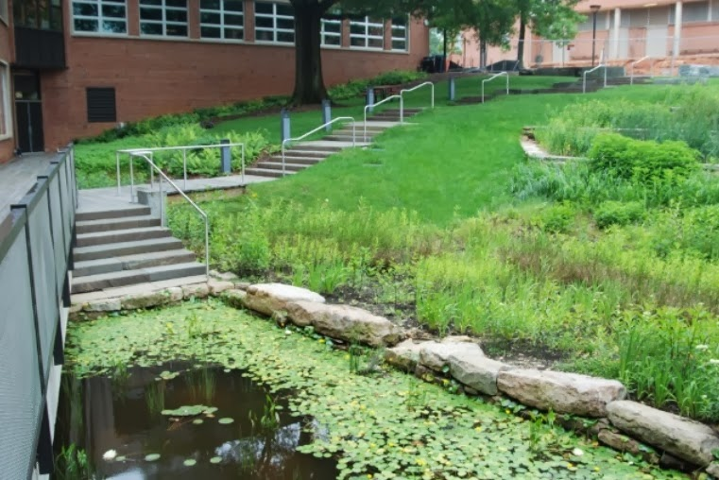
School Wetland

Slide 8
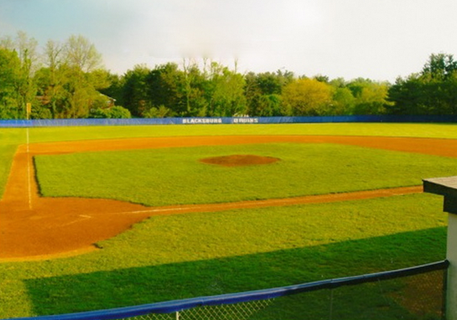
Design Field for More Sports

Slide 9
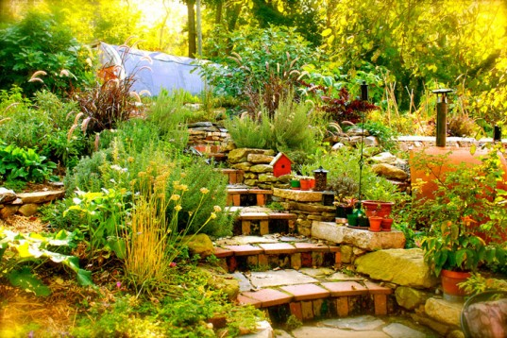
Other Ideas:
More benches around the school?
More teeter-totters, merry go rounds, slides?
Rose garden
Greenhouse

Slide 10
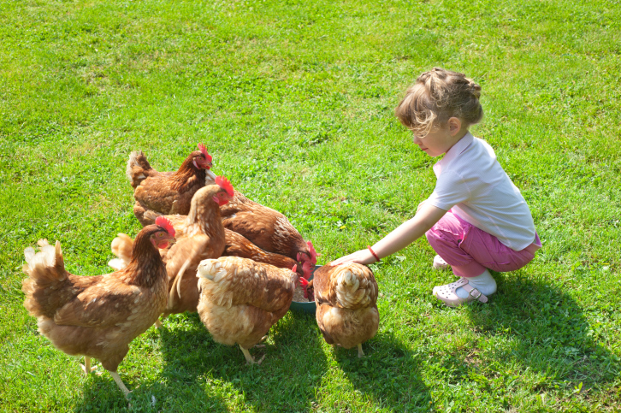
More Chickens

