Slide 1
Persuasive Writing

Slide 2
Persuasive Writing
Purpose: to persuade someone
We use reasons, explanations, and examples to convince someone that we are right
We use persuasive speech everyday without even knowing it

Slide 4
Your writing must have:
An opinion opening: “I believe that cats make better pets than dogs.”
3 reasons: “Firstly, cats are better for indoor pets …” Use examples.
Closing sentence: “As you can see, it is much better to choose a cat for a pet.”
Your writing should have 8 – 10 sentences

Slide 5
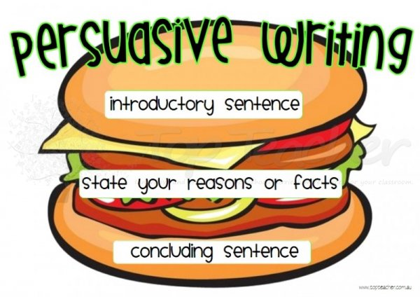

Slide 6
Your Mission!
You will write a persuasive letter to the principal to convince him to have a “special” day of your choice, once a month.
For example, if I wanted a hot dog day, I would write about this.

